Slide 1

Building Standards-Based Learning Tools for Canvas using the Tsugi Application Environment
PRESENTATION BY:
Charles Severance, University of Michigan School of Information
Notes:
v

Slide 2




About me
https://www.dr-chuck.com/racing

Slide 3

The Learning Ecosystem of the Future
We need a way to build learning tools quickly without waiting for an LMS upgrade
IMS Learning Tools Interoperability (LTI™) provides a way to integrate learning tools
The LTI family of standards is getting more robust (and complex) all the time
We need to move from building "missing LMS tools" to "better teaching tools"
We need to enable LTI tool development at a campus or even a course level
Source: Ian Dolphin

Slide 4
The Learning Ecosystem of the Future
We need a way to build learning tools quickly without waiting for an LMS upgrade
IMS Learning Tools Interoperability (LTI™) provides a way to integrate learning tools
The LTI family of standards is getting more robust (and complex) all the time
We need to move from building "missing LMS tools" to "better teaching tools"
We need to enable LTI tool development at a campus or even a course level
Sharable
Source: Ian Dolphin

Slide 5

DEEP LINKING®
CC®
LTI®
IMS CONTENT ITEM® FILLS THE GAPS AND MAKES CONNECTIONS BETWEEN IMS LEARNING TOOLS INTEROPERABILITY® AND IMS COMMON CARTRIDGE®.
LTI®, CC®, and Content Item® are trademarks of IMS Global Learning Consortium, Inc. (www.imsglobal.org)

Slide 6
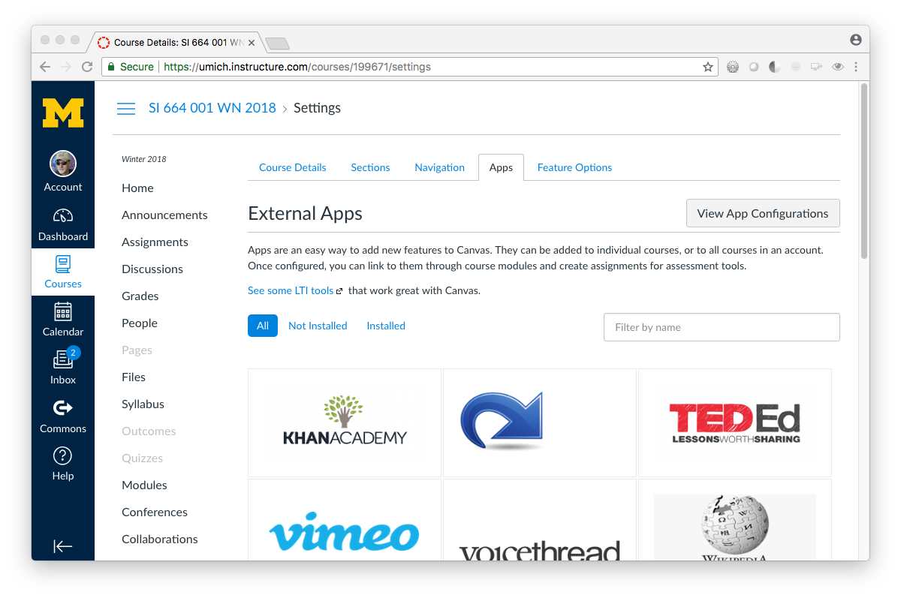

Slide 7



@whitmer
@drchuck
@brackenm

Slide 8

About Tsugi
Tsugi (Japanese for “next”) provides a way to develop and and host “learning tools. As part of its core architecture, Tsugi implements standards like IMS Learning Tools Interoperability(™), IMS Content Item(™), and Google Classroom.
100% free and open source
Increases learning tool developer productivity
Supports LTI standards
Improves the quality, maintainability, and scalability of the resulting tools

Slide 9
Put another way..
You just migrated to Canvas. Can you write a "module", "tool", or "building block" to fill a local unmet need? That’s where Tsugi comes in ☺
100% free and open source
Increases learning tool developer productivity
Supports LTI standards
Improves the quality, maintainability, and scalability of the resulting tools

Slide 10
Using Tsugi RIGHT AWAY
Teachers / Canvas Admins
PRESENTATION BY:
Charles Severance, University of Michigan School of Information
Notes:
v

Slide 11
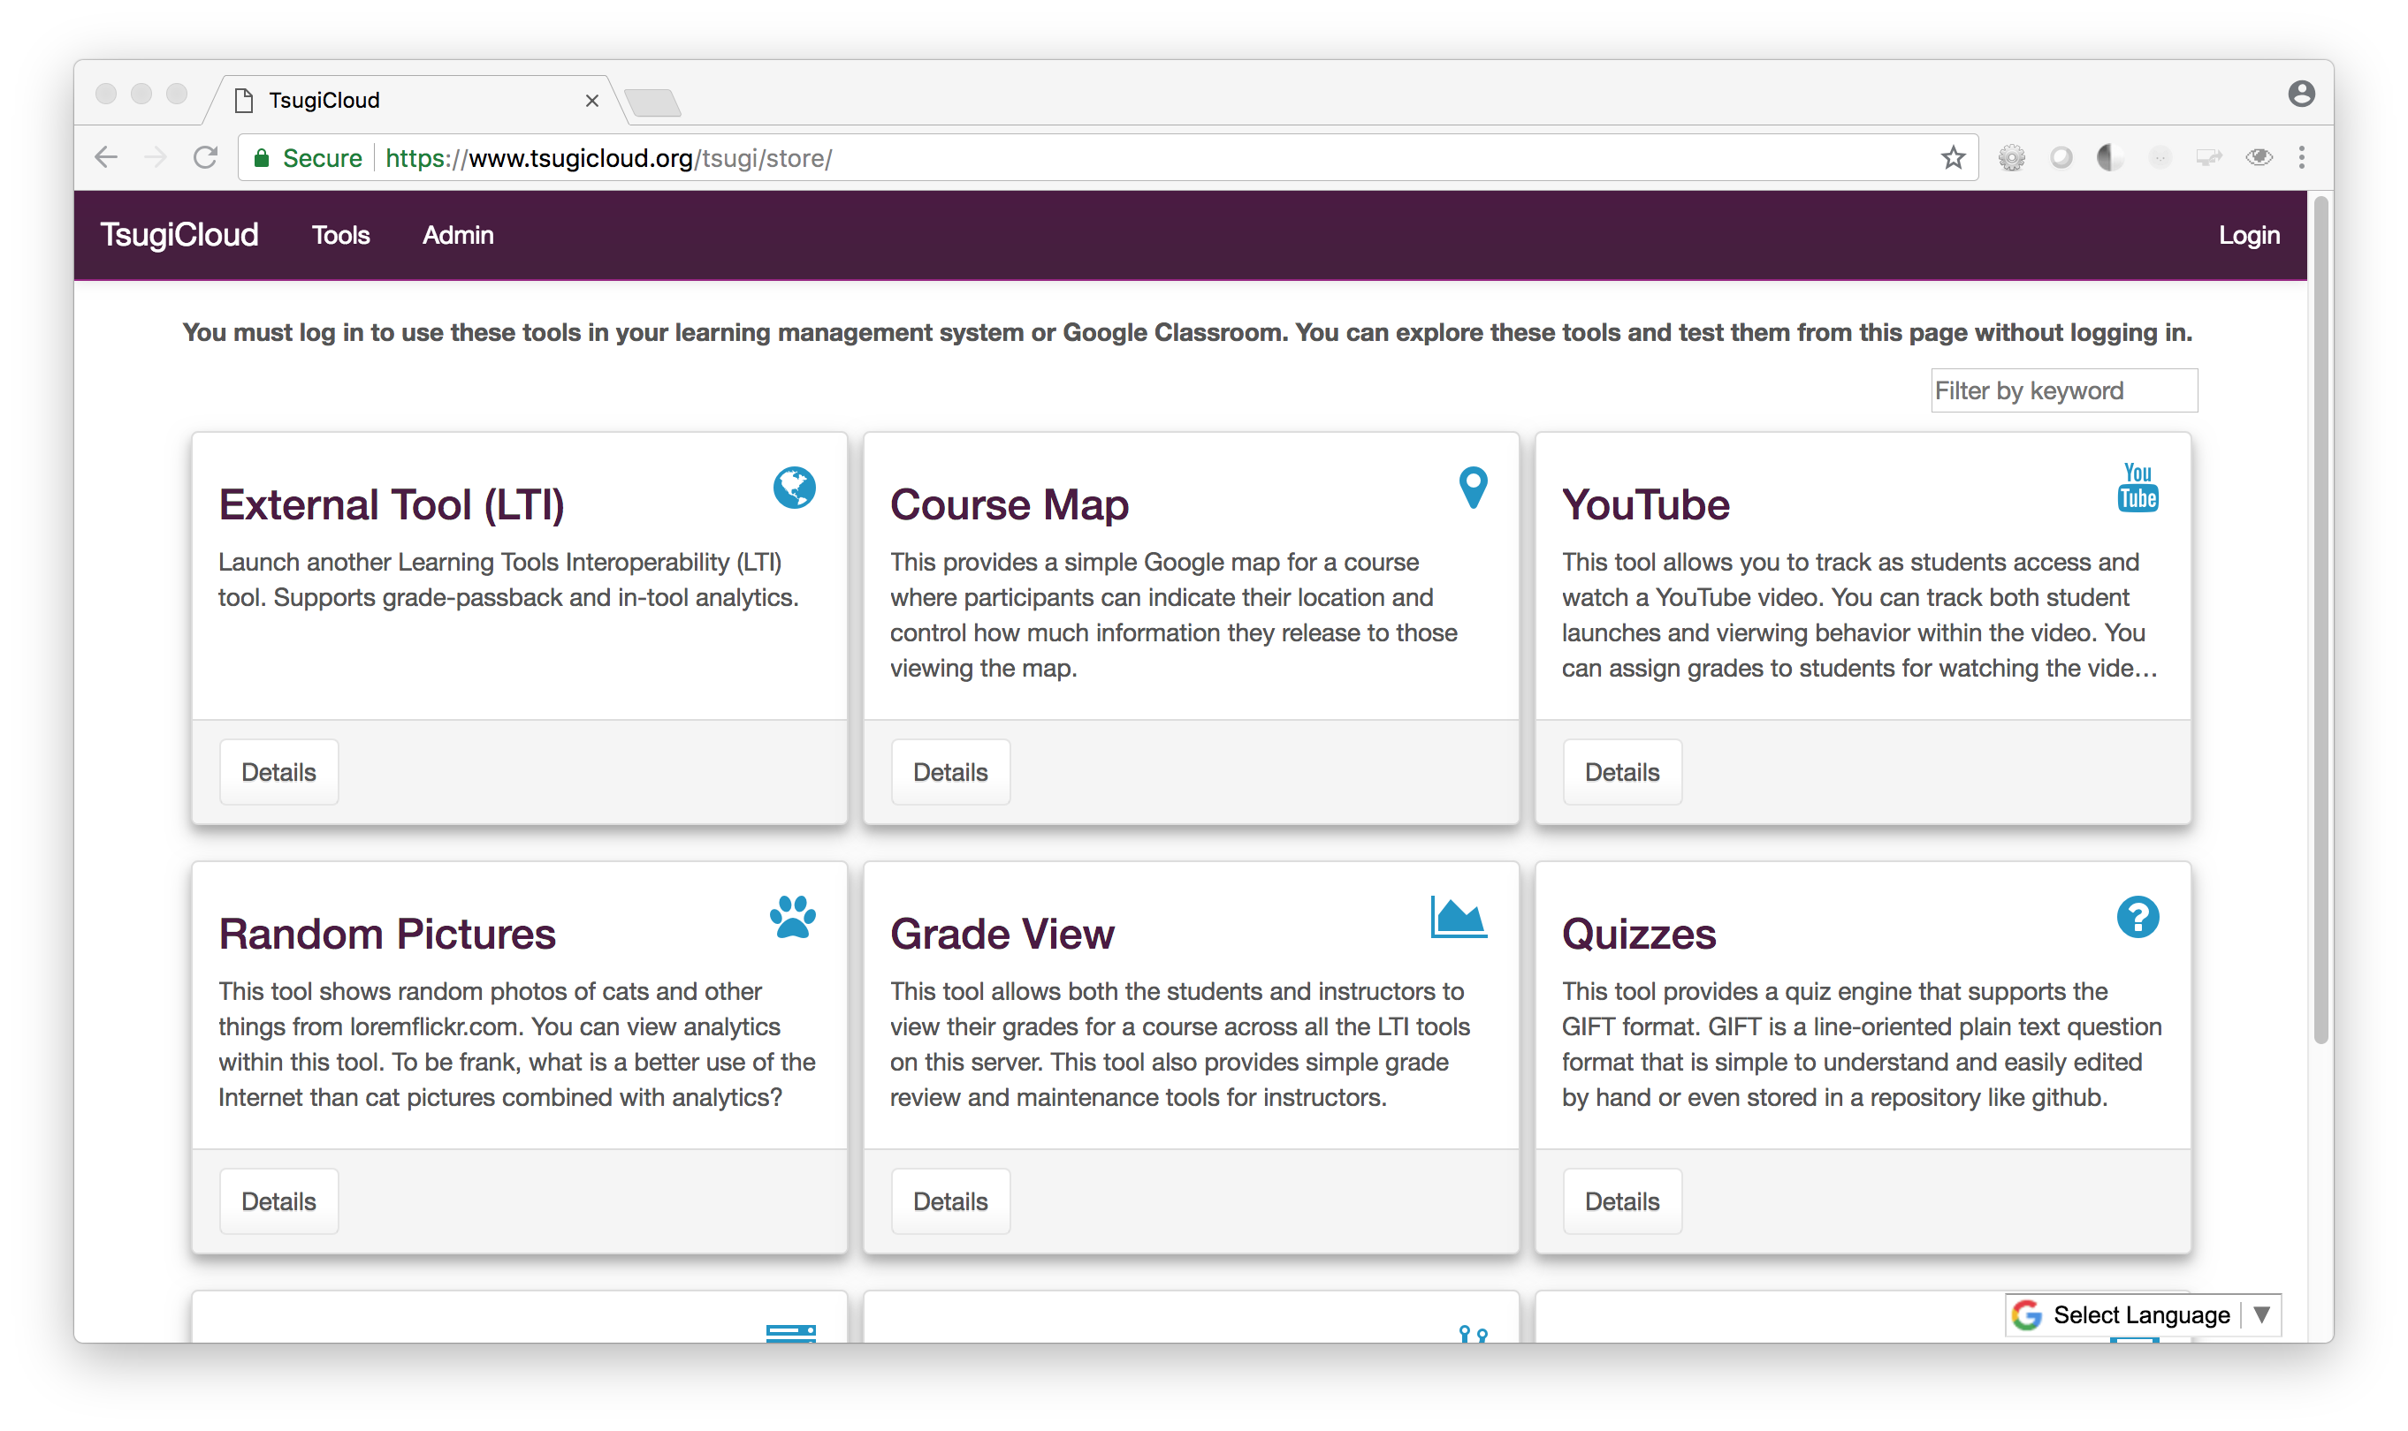
Free App Store - https://www.tsugicloud.org/

Slide 12
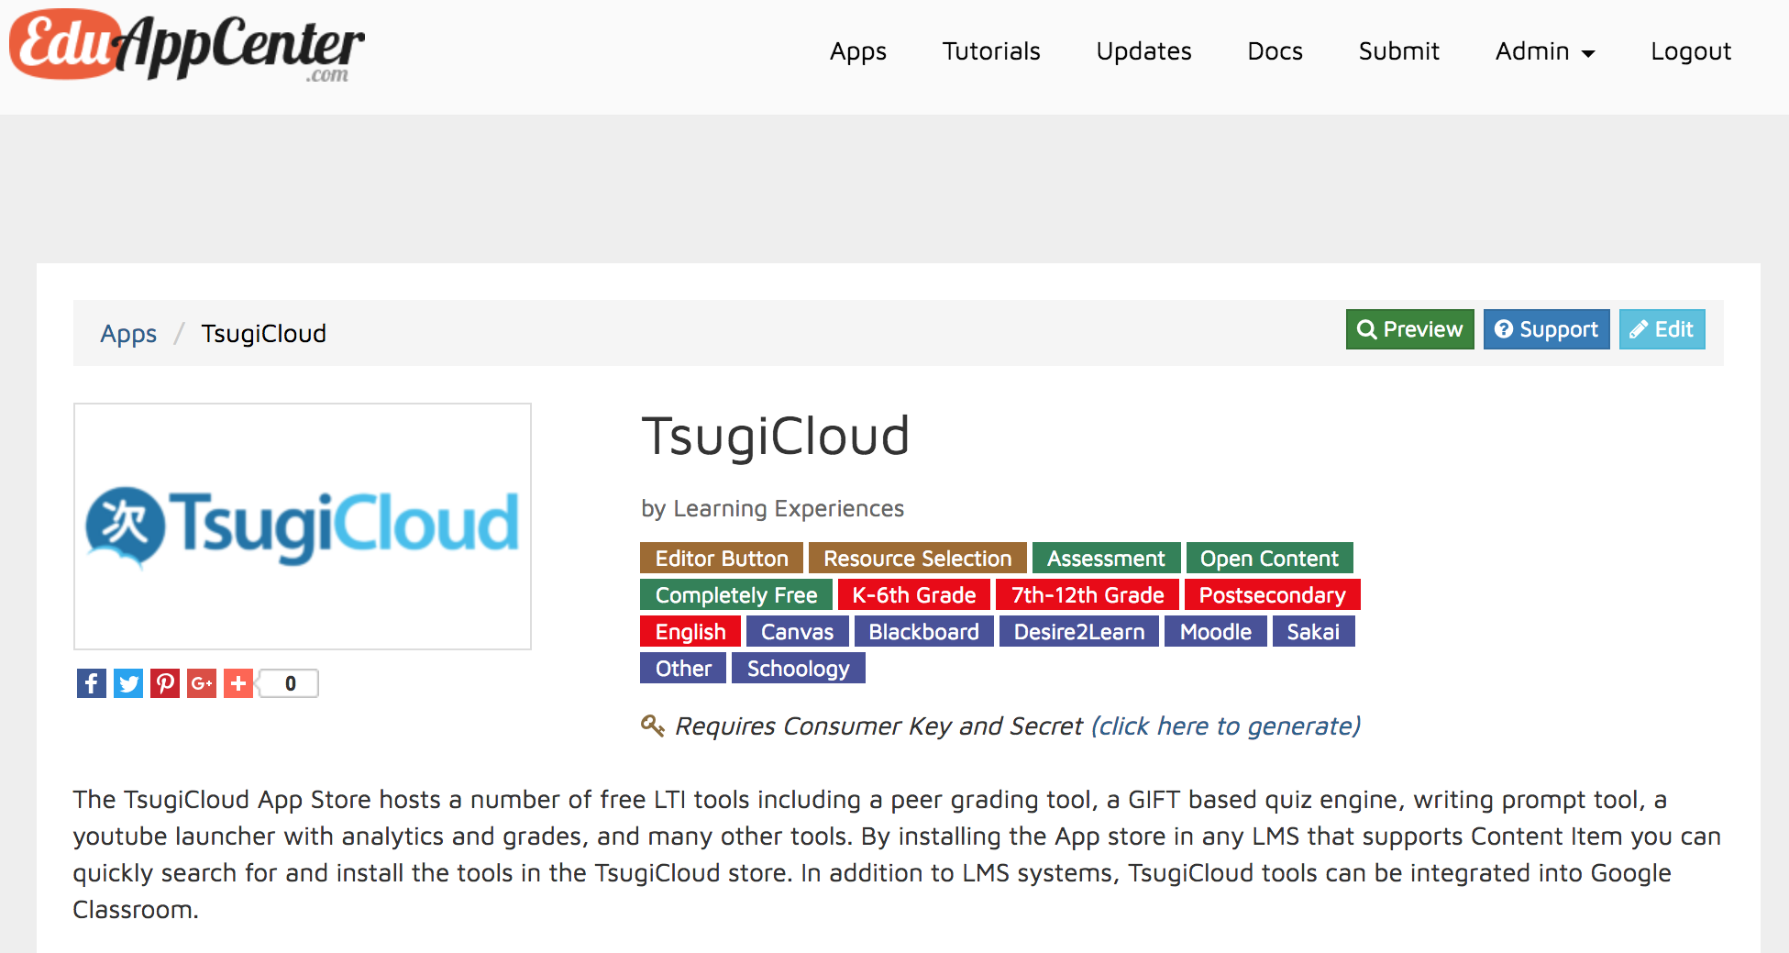
https://www.eduappcenter.com/apps/1010

Slide 13
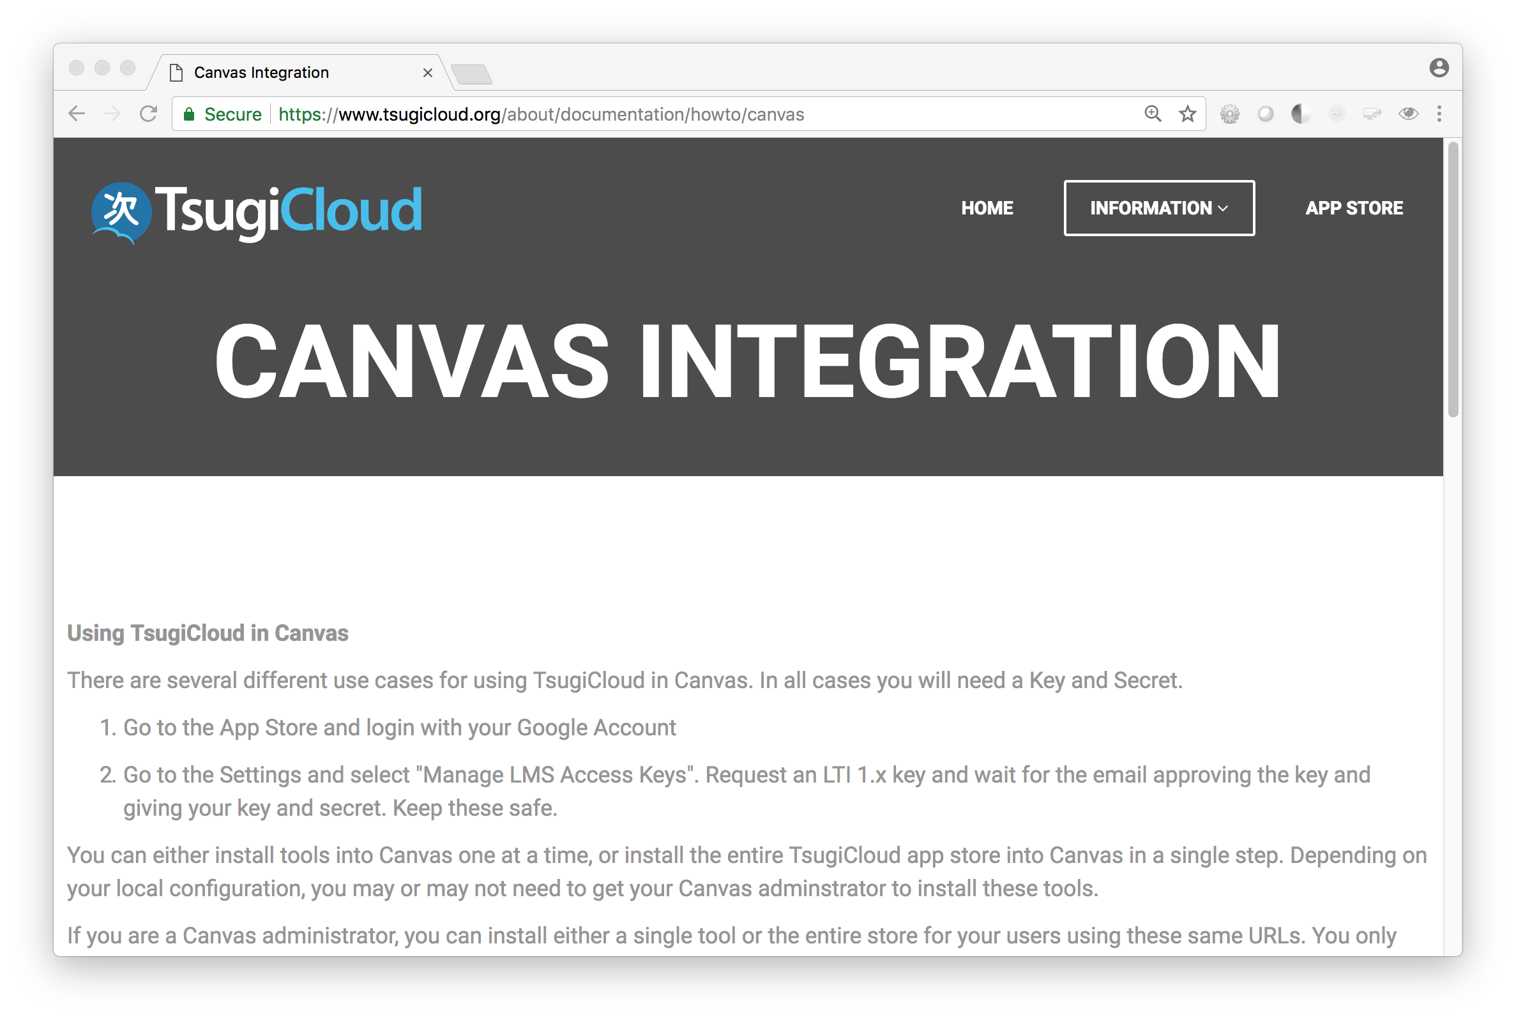
Exercise: Using TsugiCloud in Canvas

Slide 14
Why ADOPT TSUGI FOR DEV?
CAMPUS Leadership
PRESENTATION BY:
Charles Severance, University of Michigan School of Information
Notes:
v

Slide 15
Tsugi multiplies your capabilities …
LTI 1.0, LTI 1.1, LTI 2.0, Caliper, Common Cartridge, LTI Advantage …
You did not use email as logical key in the user table. Correct length!
Session Management / Extension / Expiry
Support Offline Grading – Peer grading Applications
Coping with unreliable Tool Consumers – Grade resend
Build Thin Cartridges From LTI Links
Handling Settings on URL, Custom parameters, etc.
Support Cross-LMS Setting Dialogs
Make use of windows.post messages to resize iframes

Slide 16
Advantages of Tsugi Tools
Work with lots of LMS's even though you never tested with more than one
Even when those LMS's have bugs!
You don't set cookies in iframes
You can handle multiple courses / roles in multiple tabs
Handle LMS's that don't give you features (i.e. placement settings)
You don't do navigation inception.
You handle weird / changing lis_sourcedid values from Moodle
You can reliably / securely connect LTI accounts with direct logins
You have a flexible UI / work flow for issuing keys (LTI 1.1 and LTI 1.3 soon)
Your tool works with Google Classroom – is that a thing?

Slide 17
Tsugi gets you in the cloud easily
You have a hosting environment
Admin interface / key management / data management
You have free / open Amazon / Google recipes
Works behind CloudFlare / CDN / Proxy
Designed for 100% uptime in the cloud - auto upgrade code/database
Like a WordPress for your learning tools
You can contribute your tool to an open app store like TsugiCloud.org
You can make money submitting your tool from a commercial app store

Slide 18









IMS LTI® IMS Deep Linking® IMS Common Cartridge®

Slide 19
DEVELOPING W / Tsugi
Developers
PRESENTATION BY:
Charles Severance, University of Michigan School of Information
Notes:
v

Slide 20
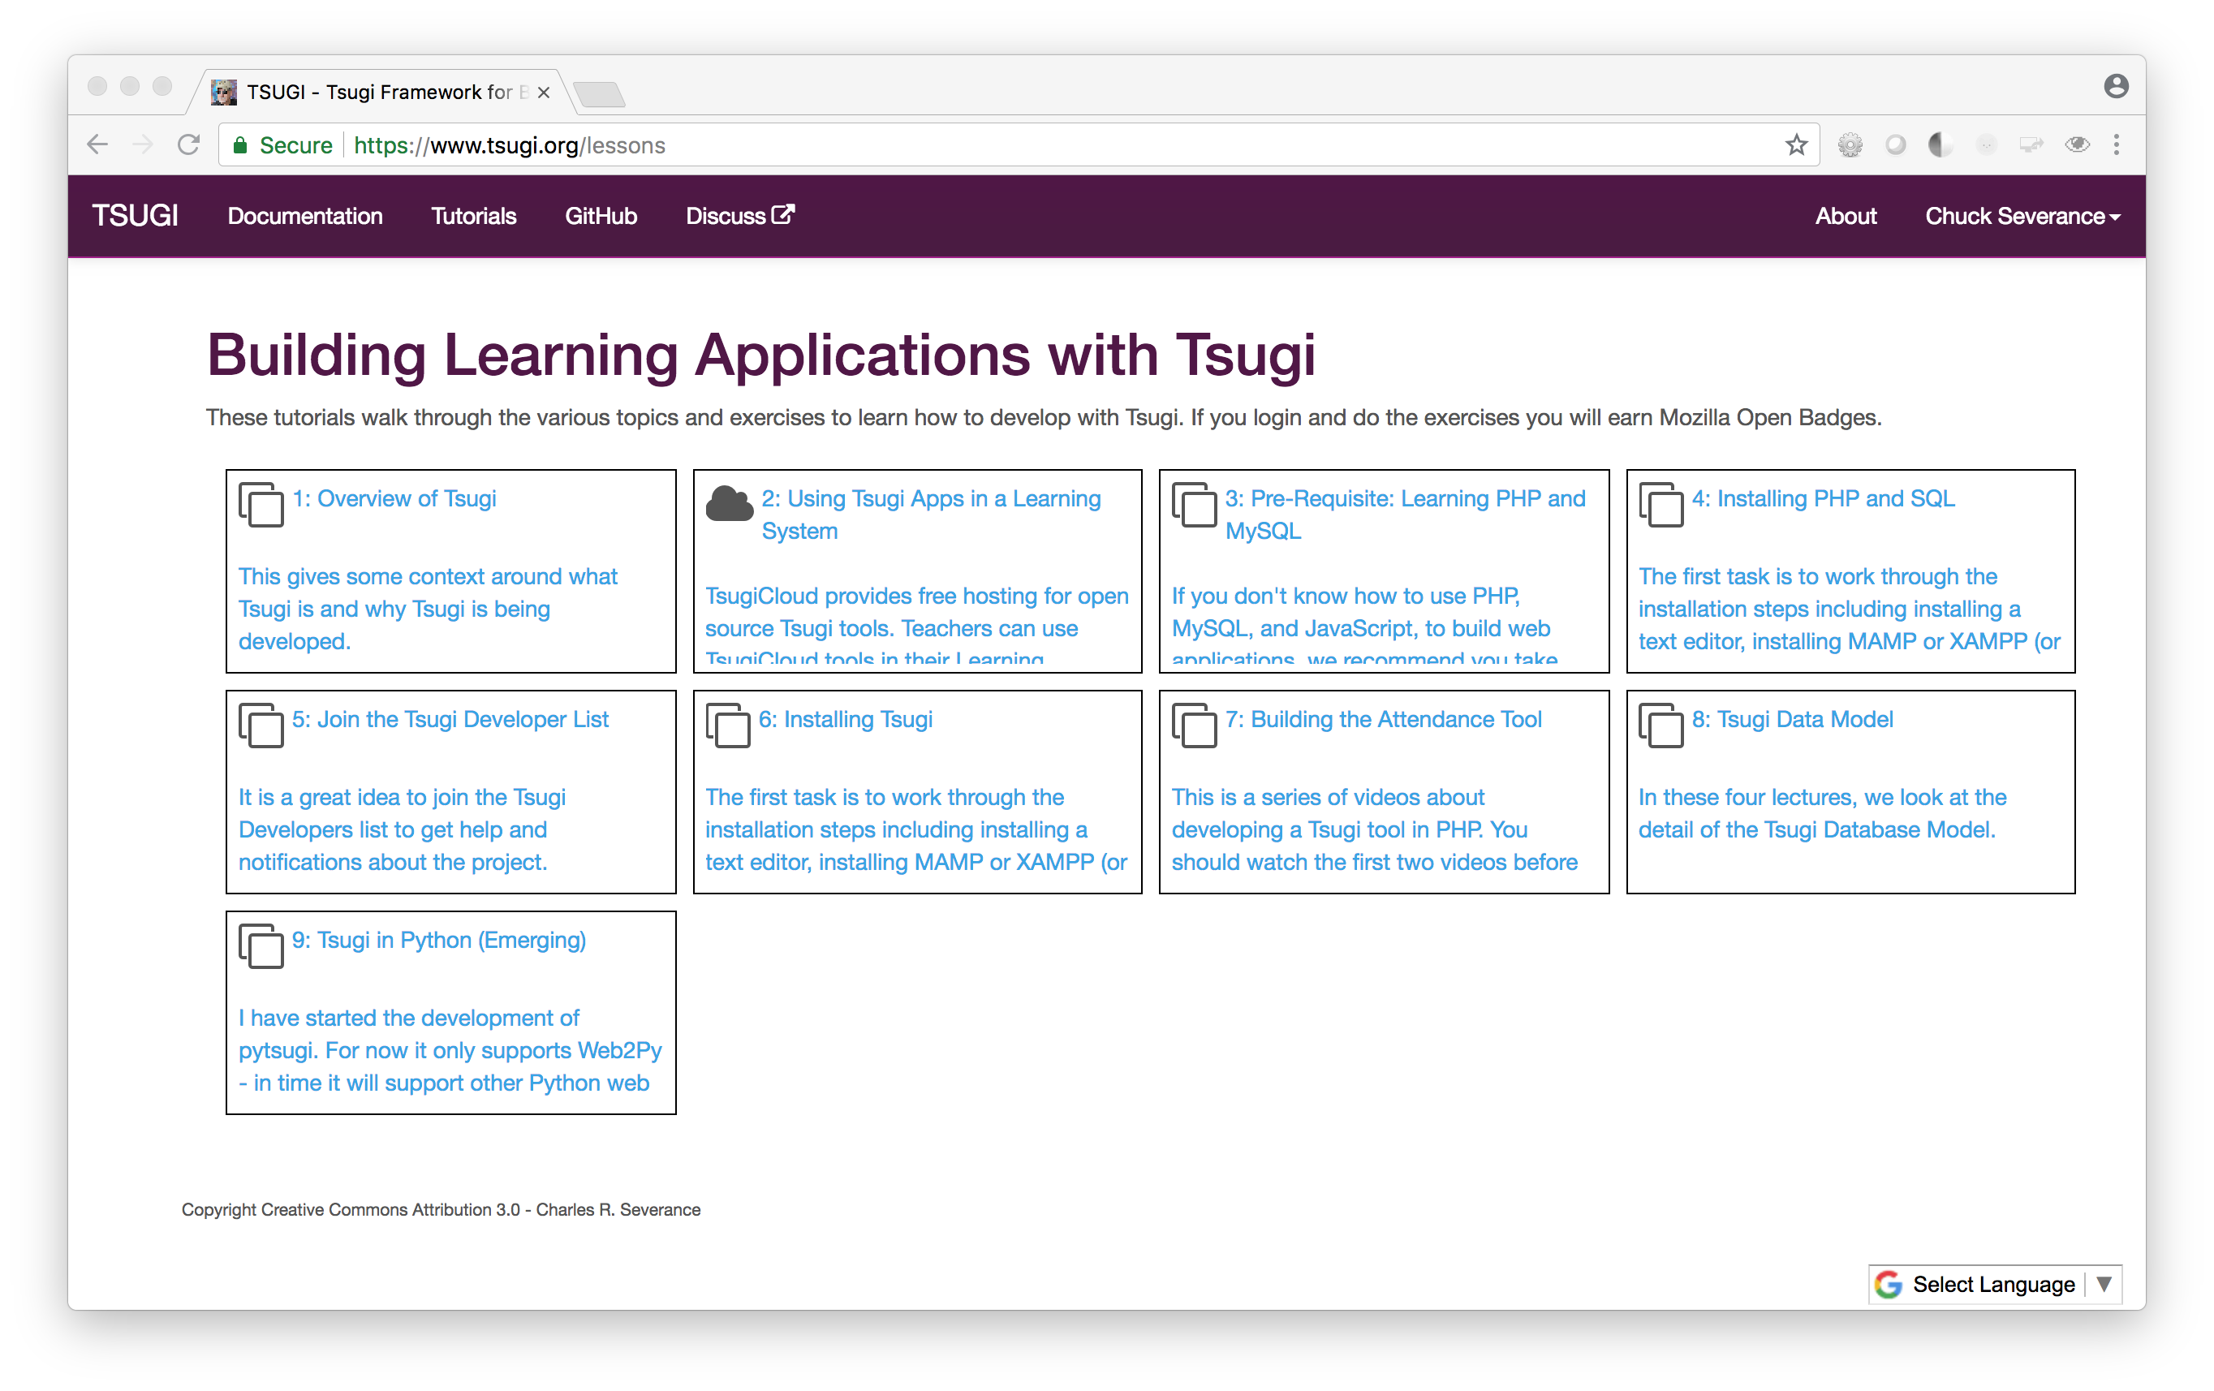
Developer Training
https://www.tsugi.org/lessons

Slide 21
<?php // https://github.com/tsugiproject/trophy require_once "../config.php"; use \Tsugi\Core\LTIX; // Handle all forms of launch $LTI = LTIX::requireData(); // Render view $OUTPUT->header(); $OUTPUT->bodyStart(); $OUTPUT->topNav(); $OUTPUT->welcomeUserCourse(); if ( ! $LTI->user->instructor ) { echo('<p><i class="fa fa-trophy"></i>'); echo(' You earned a trophy!</p>'); $LTI->result->gradeSend(0.95, false); } $OUTPUT->footer();
A Minimal Tsugi Tool

Slide 22
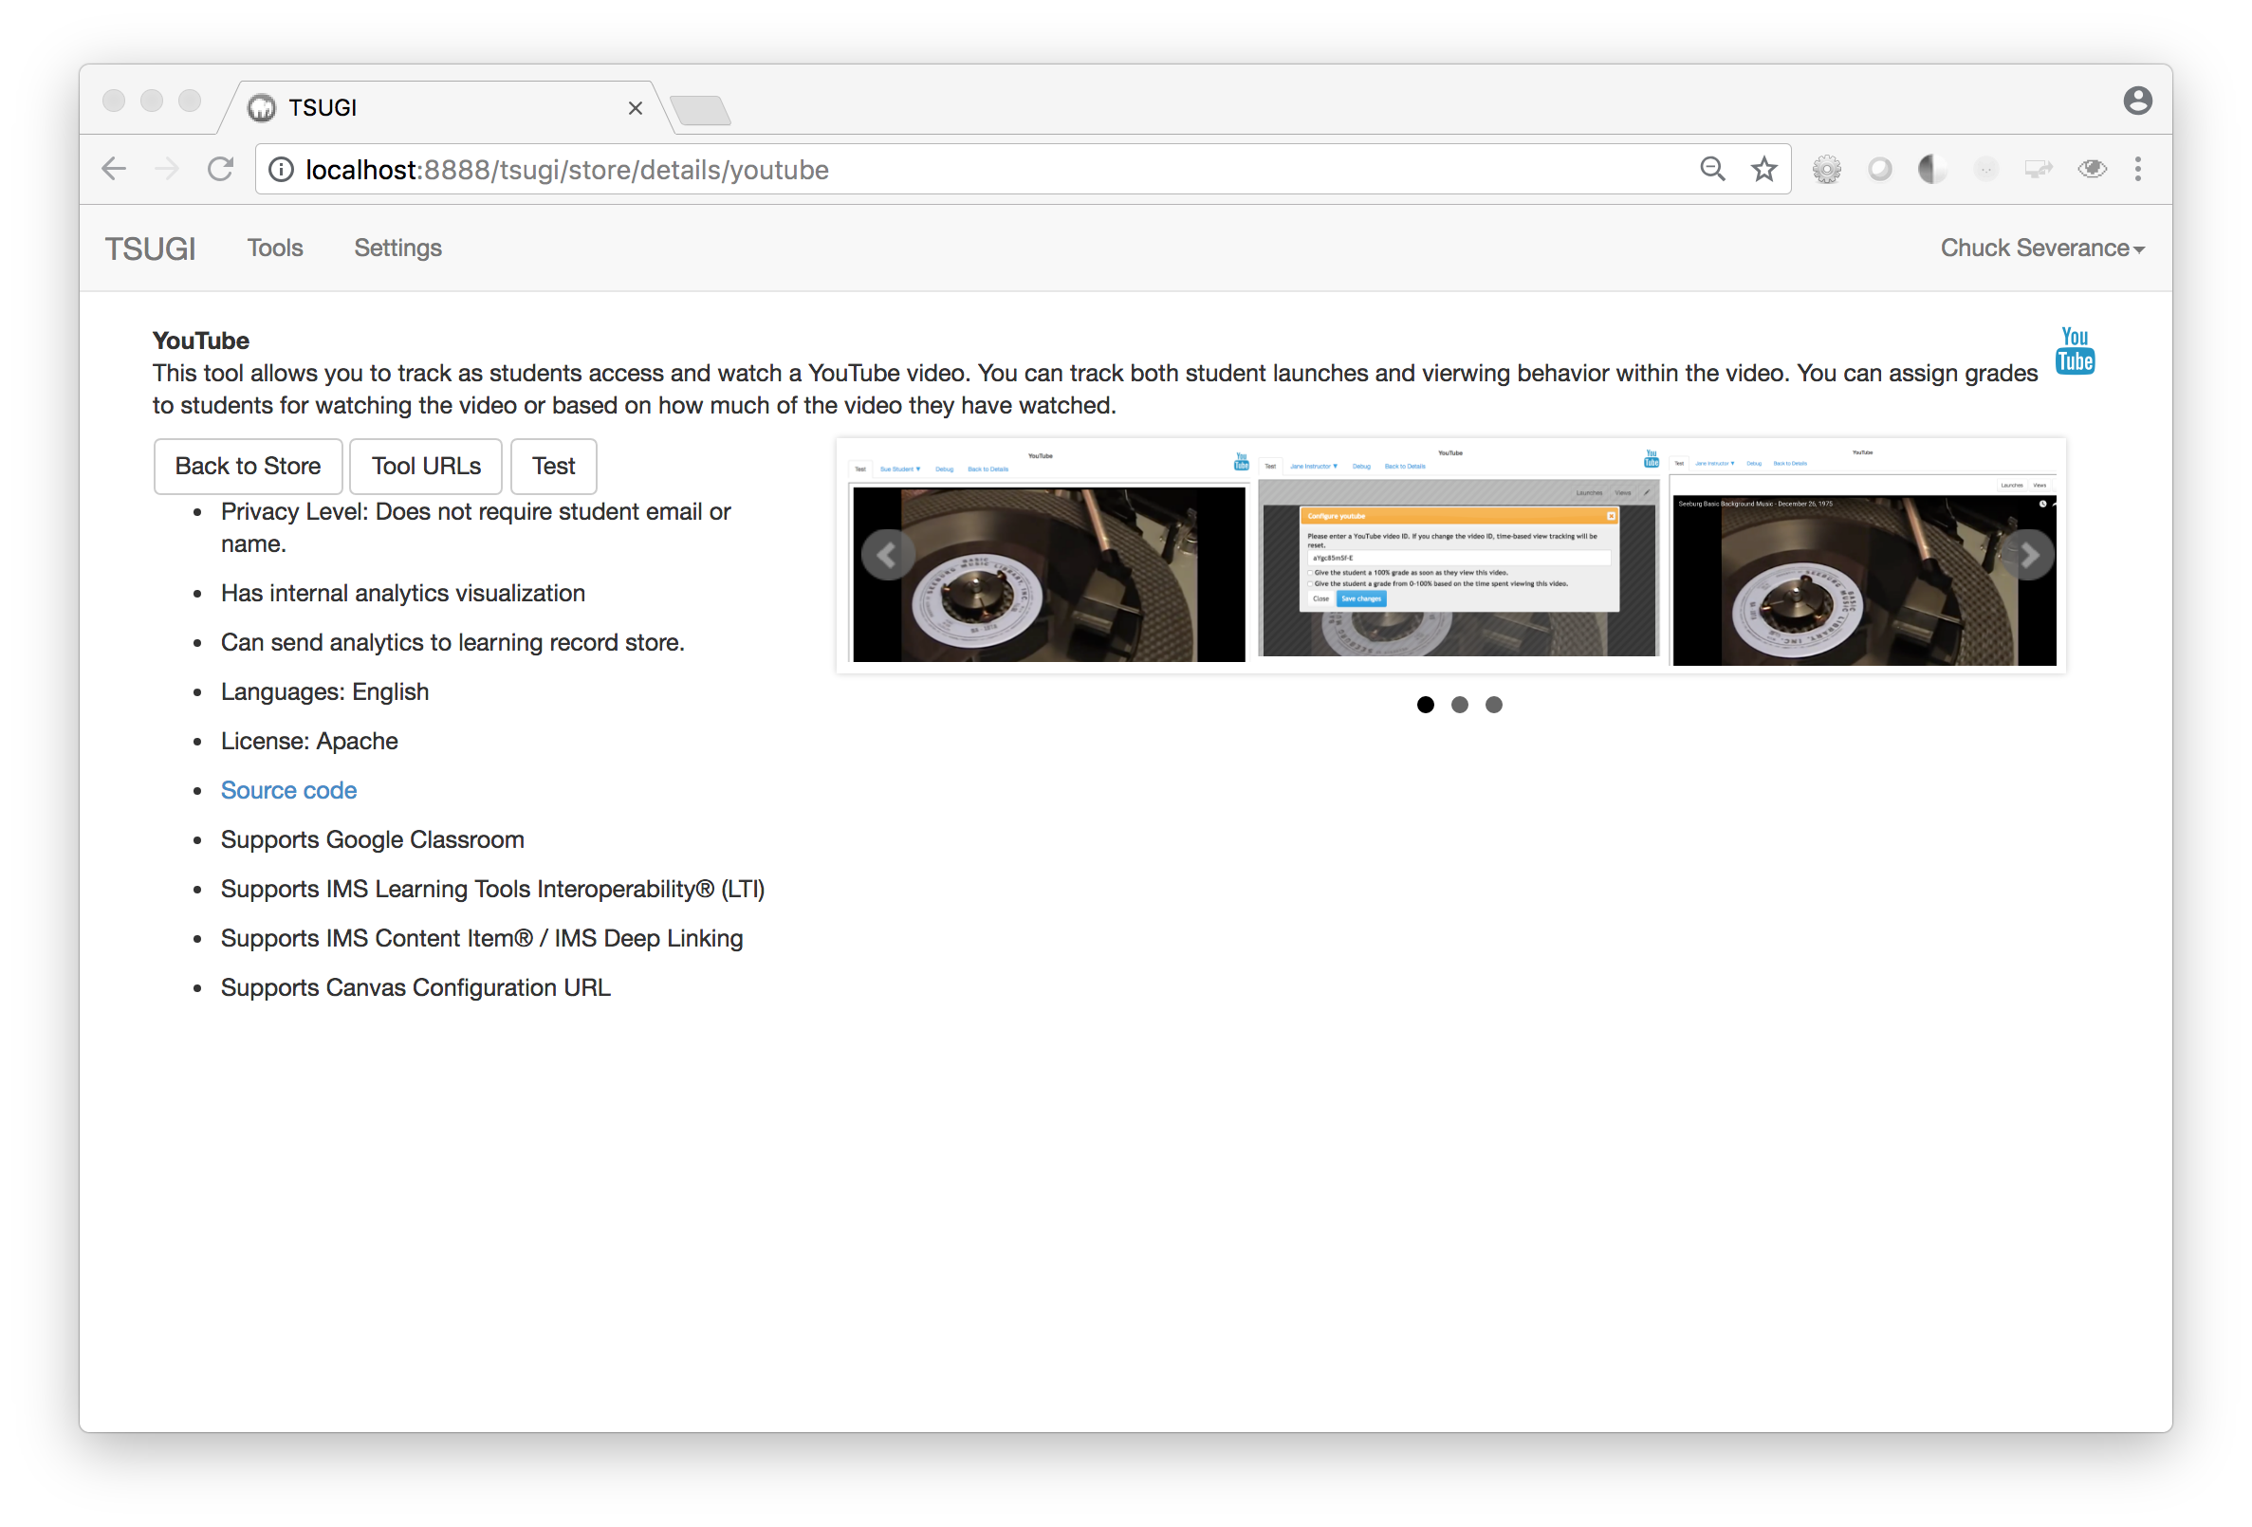
Developer Environment

Slide 23
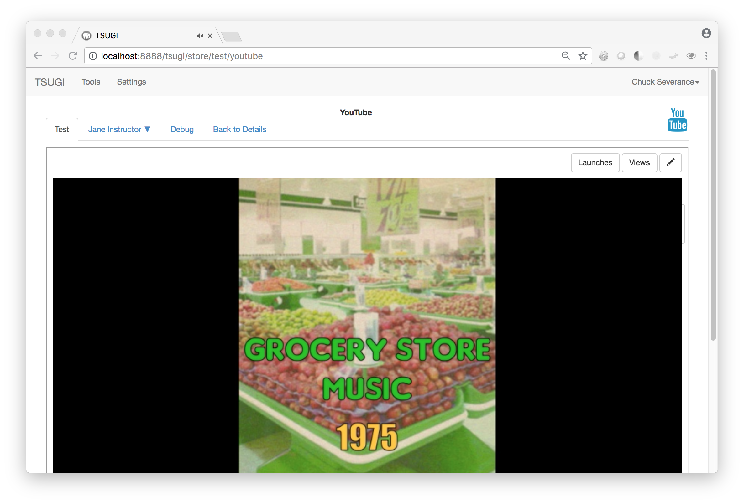
Test Harness

Slide 24
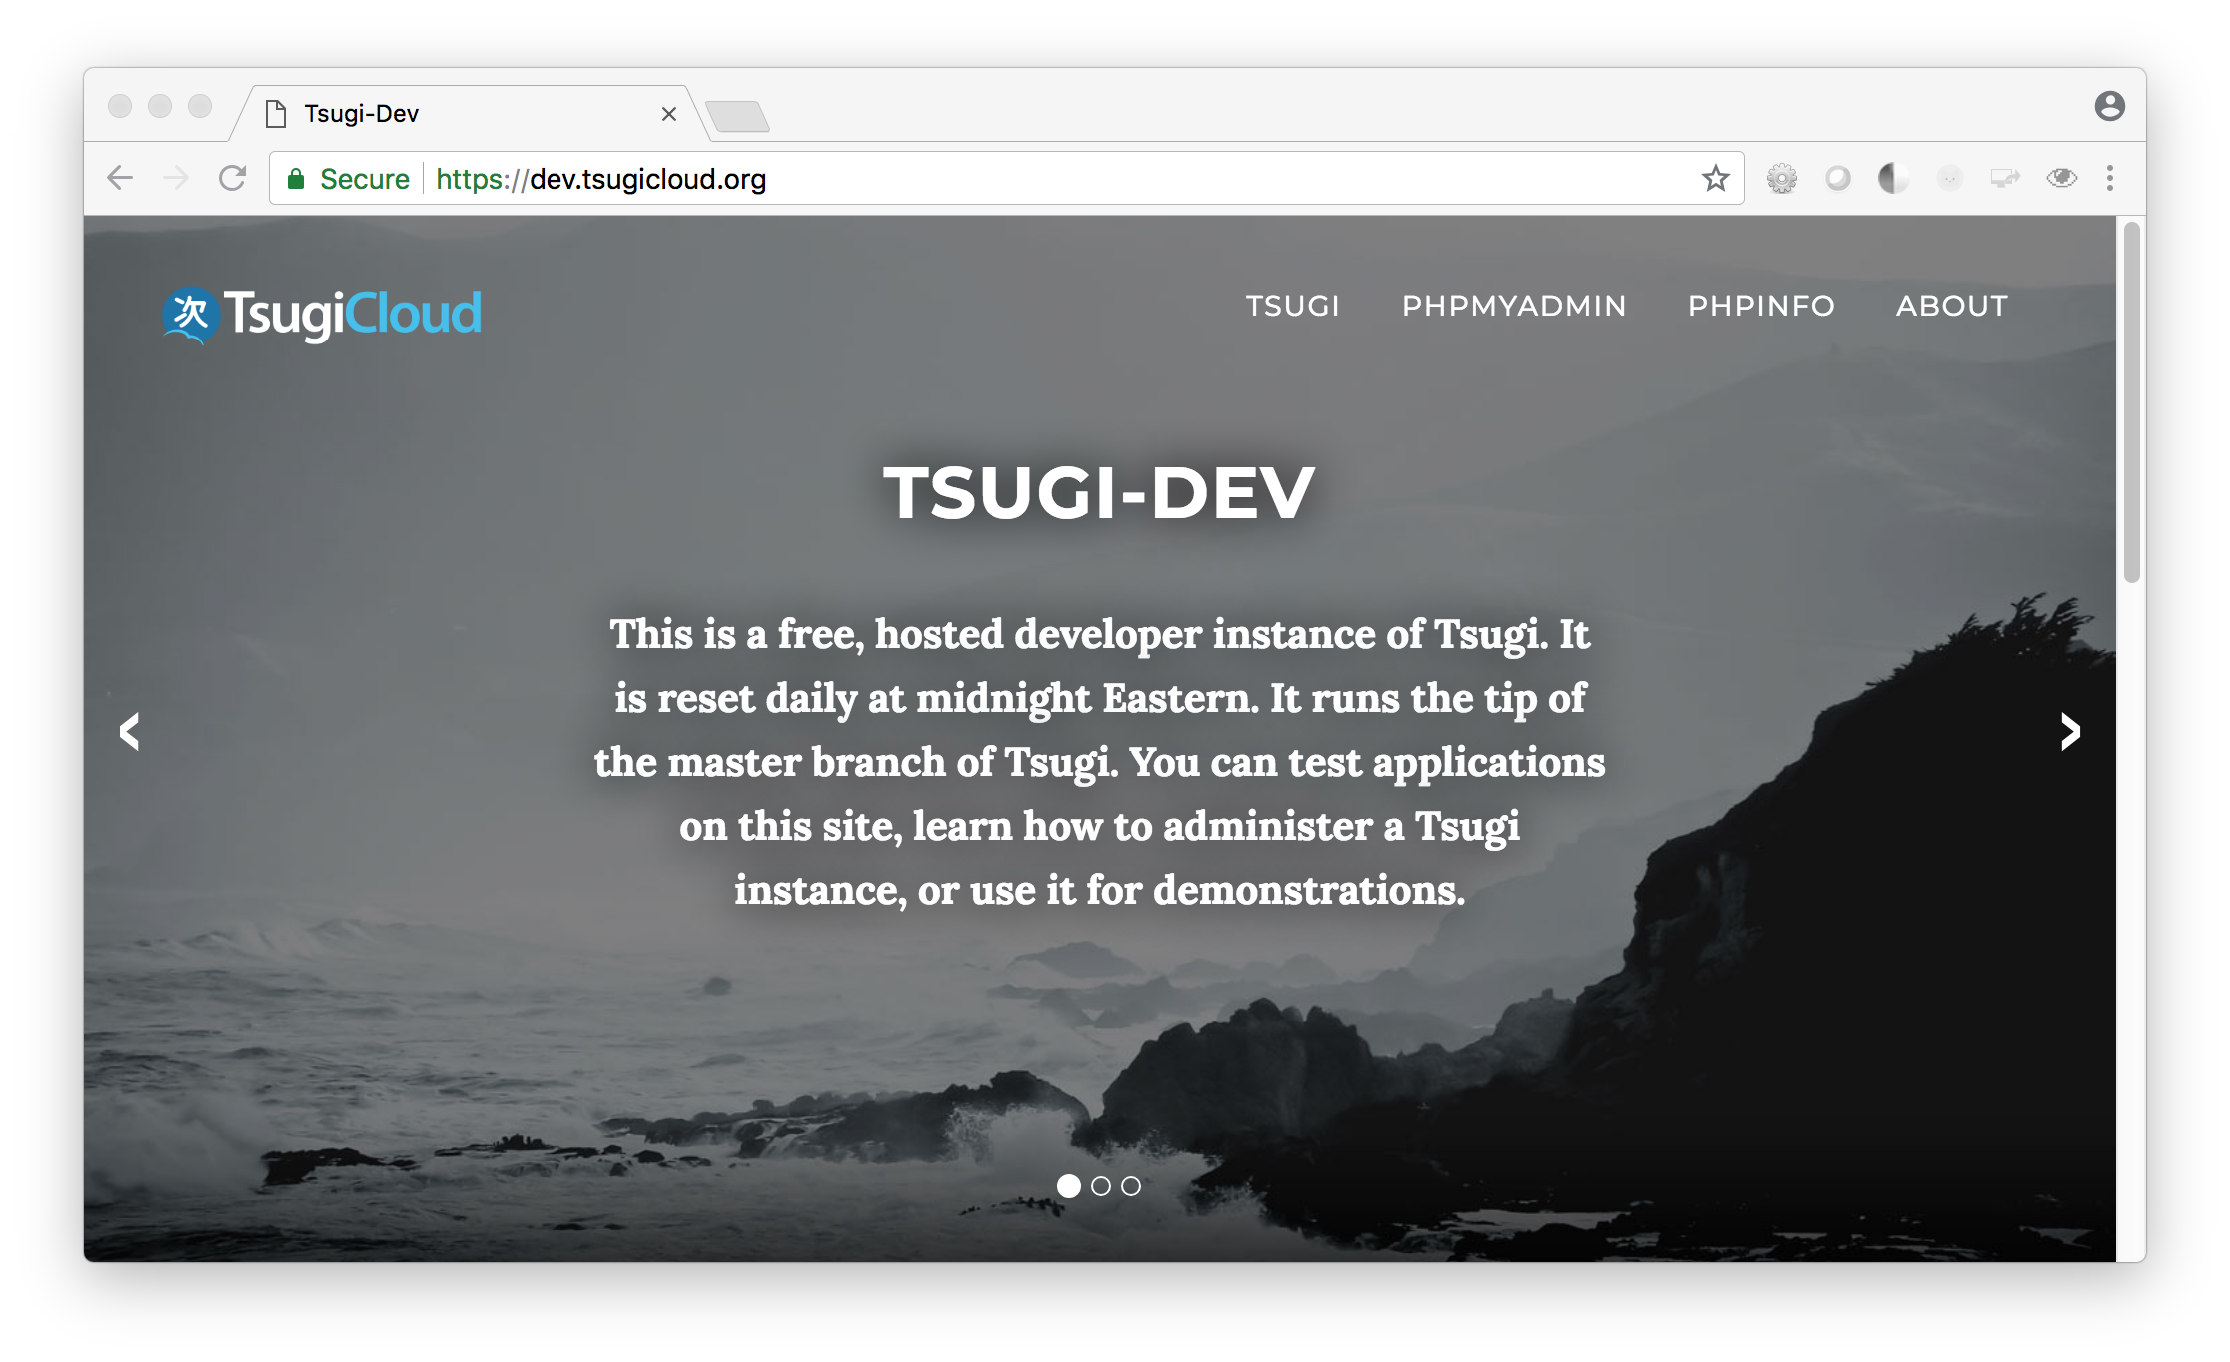

Slide 25
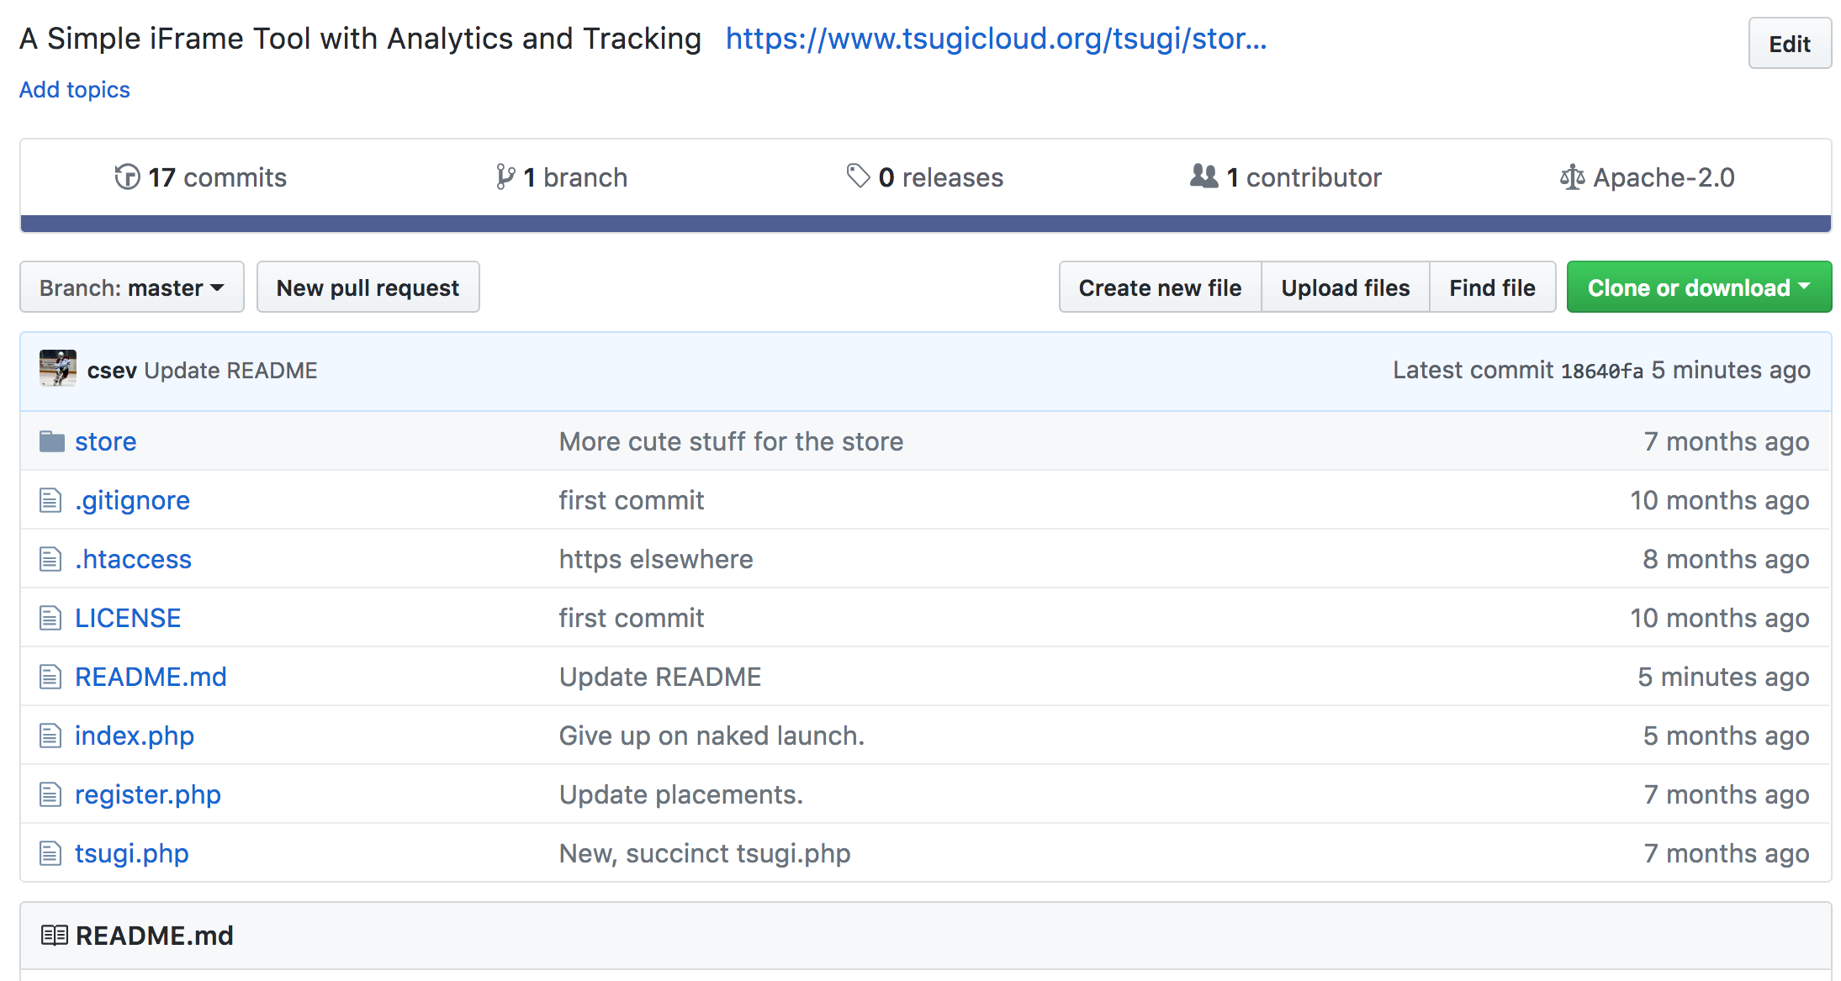
https://github.com/tsugitools/iframe

Slide 26
LTI 1.3
LTI 1.3
Java Web Tokens for Signing
OAuth 2.0
Public / Private Keys
More complex – but better library support
Tsugi PHP already "supports" LTI 1.3 launches
Prototyped at 2018 Learning Impact – May 2018

Slide 27
IMS LTI® IMS Deep Linking® IMS Common Cartridge®

Slide 28
What if you combined a PERSONAL L.O.R. and an App Store?
DANGER
Notes:
v

Slide 29
#STANDARDS
#MOOC
#OERContent
#100PercentFree
#LOR
#OERBook
#Translations
#FreeEducation
#NGDLE
#100KApps
Notes:
v

Slide 30
DEEP LINKING®
CC®
LTI®
FOR THE FIRST TIME IN THE HISTORY OF EDUCATIONAL TECHNOLOGY, YOU CAN MAKE AN APP STORE AND LEARNING OBJECT REPOSITORY WITHOUT PROPRIETATY EXTENSIONS.
LTI®, CC®, and Content Item® are trademarks of IMS Global Learning Consortium, Inc. (www.imsglobal.org)

Slide 31



CreateSpace
20
Pandoc
py4e.com
App Store (次)
OER LOR (코스)
8K
github
1.2M
Coursera
Media
Canvas
300
archive.org
Amazon
YouTube
ITunes
Google Play

Slide 32
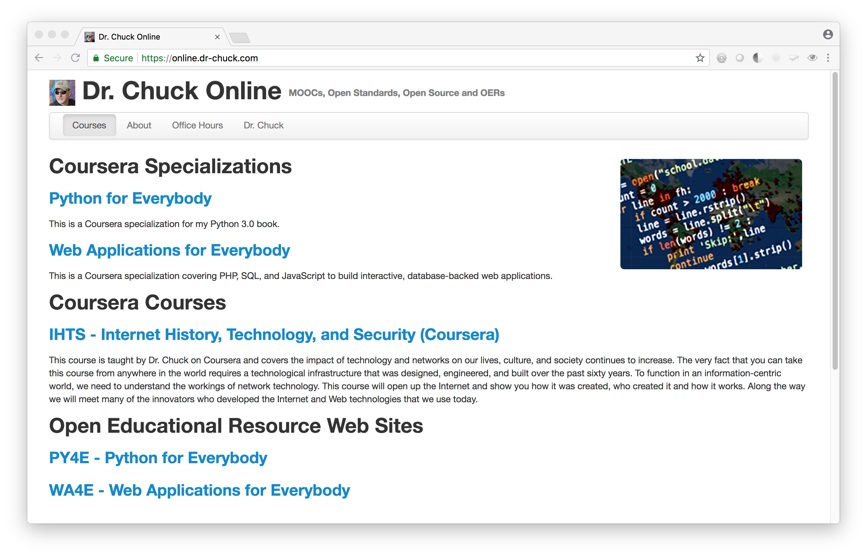
CRAZY DEMO TIME

Slide 33
If you are going to build LTI tools, take a look at tSUGI
Notes:
v

Slide 34
IMS LTI® IMS Deep Linking® IMS Common Cartridge®

